Slide 1
Driving into the Future: Launching The Next EV Dealership
Presenters:
Mariely Mena
Shem Cumberbatch
Tenzin Nyima
Mohammad Mahmud
The Washingtonians

Slide 2
AGENDA
01
INTRODUCTION
02
OBJECTIVE AND KEY FINDINGS
03
STATE POLICIES & INCENTIVES
04
RECOMMENDATION
05
SOURCES
THE WASHINGTONIANS

Slide 3
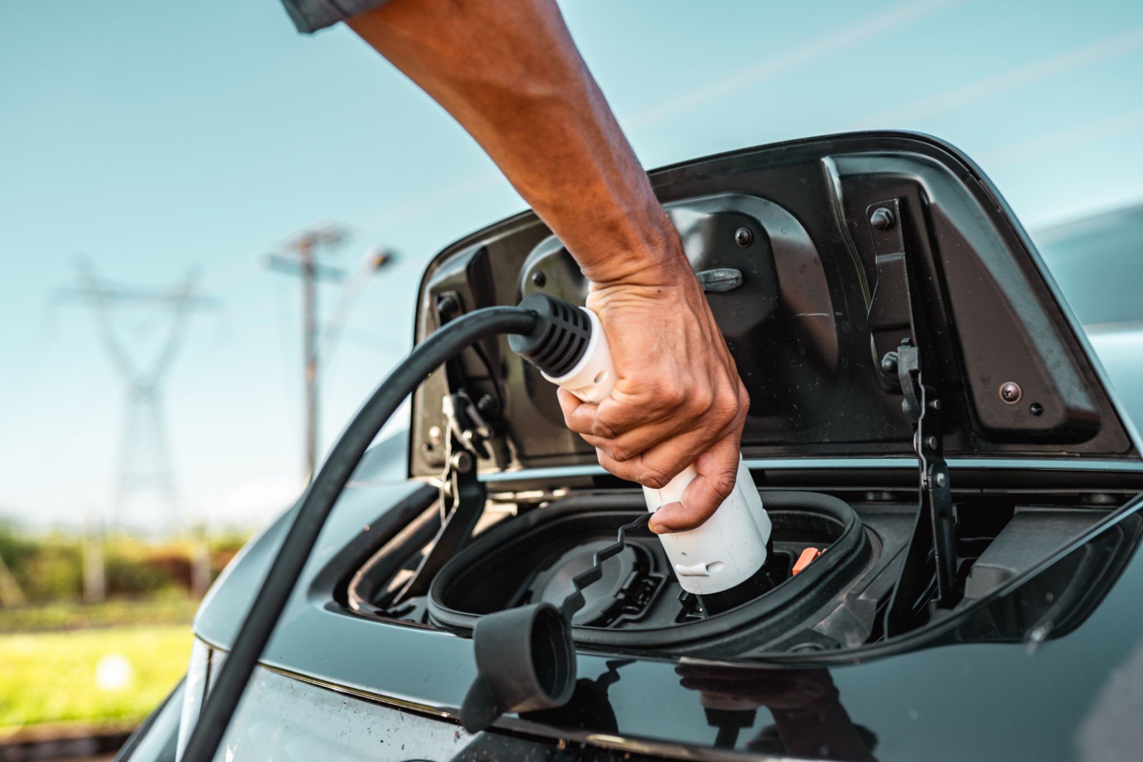
Introduction:
Welcome to our presentation
STAKEHOLDER: Investor looking to open an electrical vehicle dealership
OBJECTIVE: Identifying the ideal county in WA state to open a dealership
DATASET: Provides data on Battery Electric Vehicles (BEVs) and Plug-In Hybrid Electric Vehicles (PHEVs) currently registered through Washington state Department of Licensing (DOL)
1

Slide 4
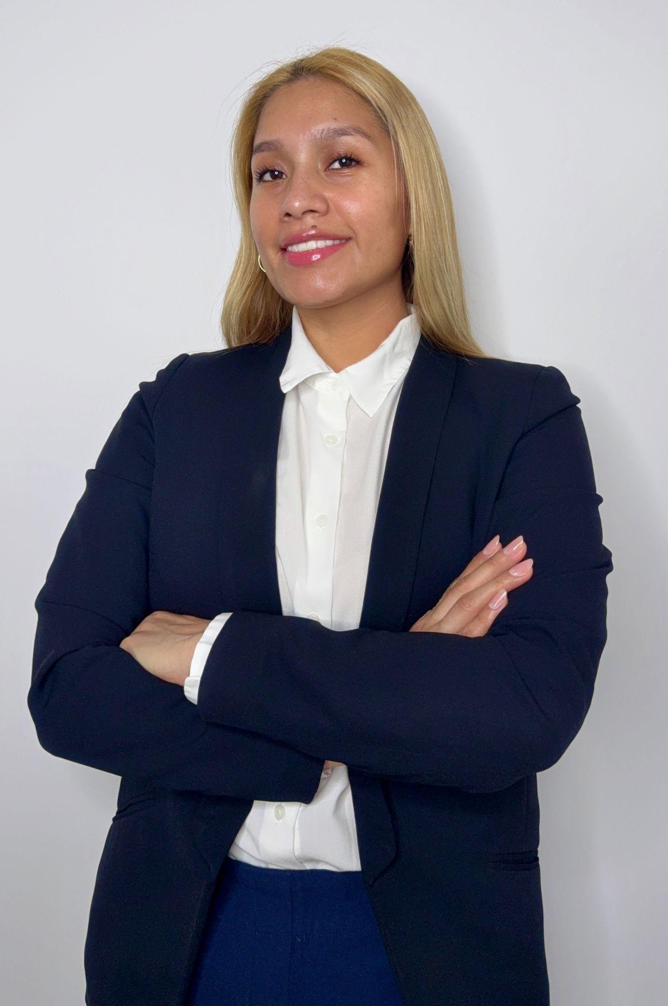
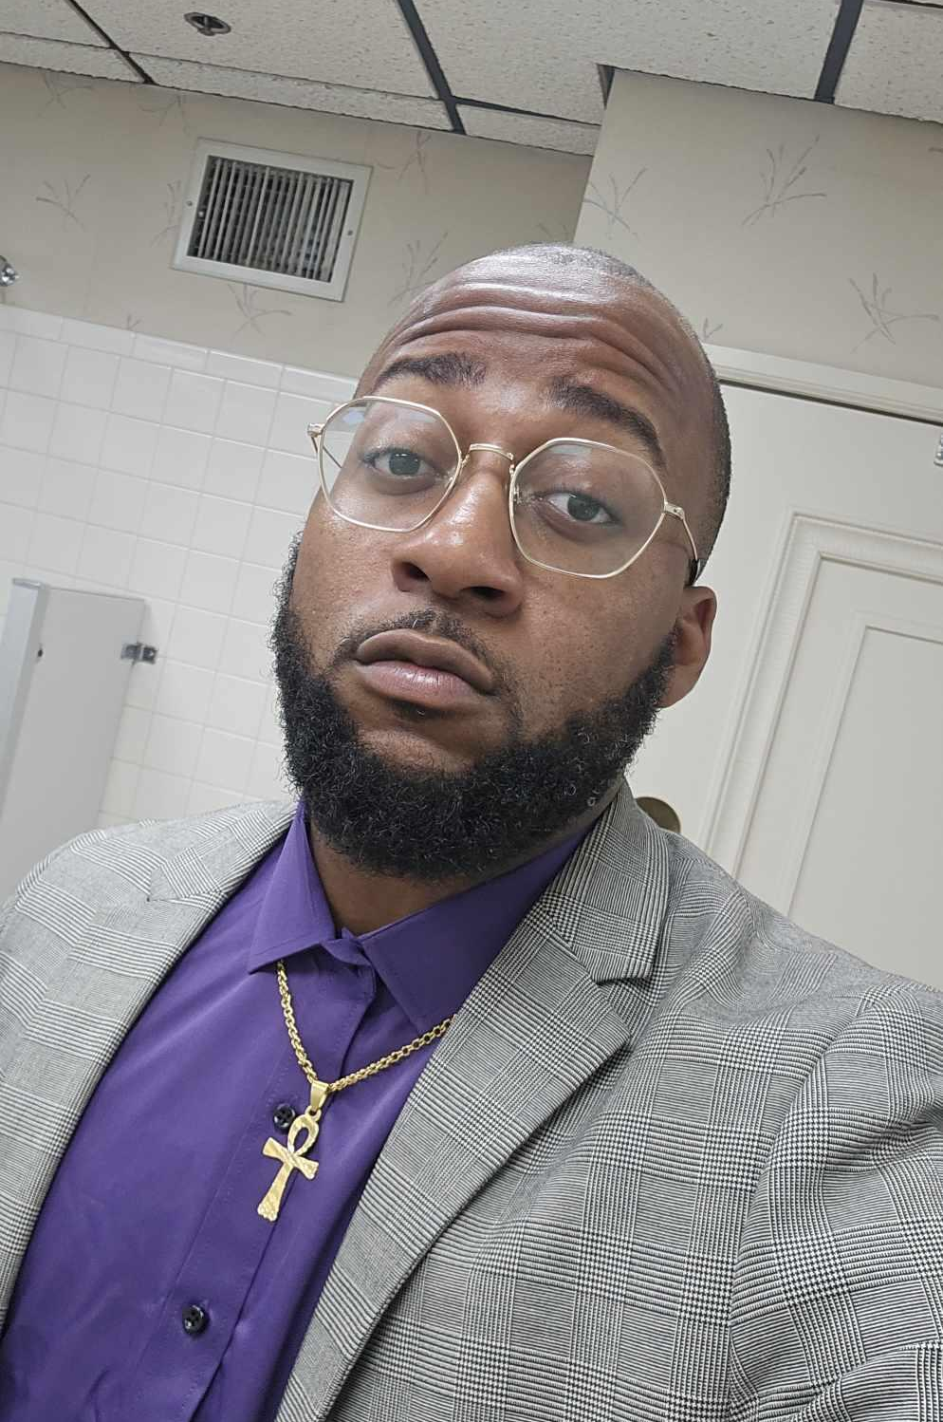
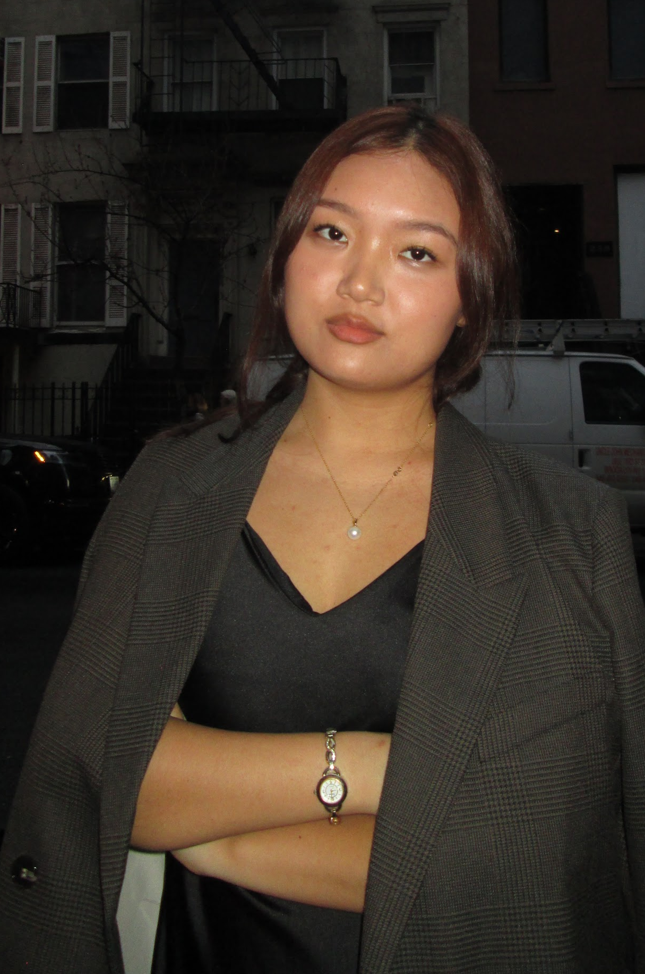

MEET
THE TEAM
Mariely Mena
Shem Cumberbatch
Tenzin Nyima
Mohammad Mahmud
Data Analyst
Data Analyst
Data Analyst
Data Analyst
THE WASHINGTONIANS

Slide 5
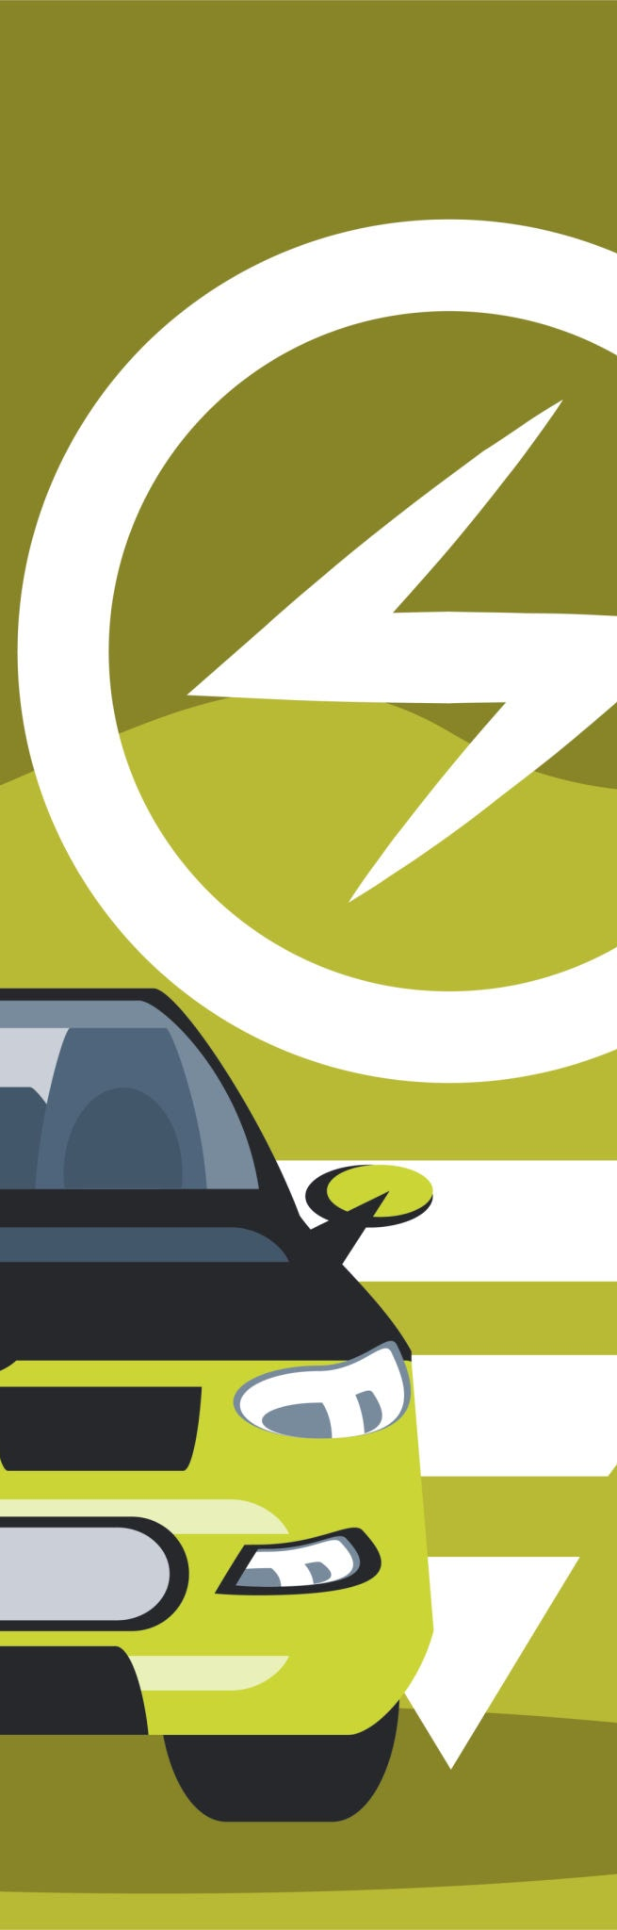
2
Objective:
Which county in Washington state is ideal to open an electrical vehicle dealership, considering charging station availability and regional trends?
Key Findings
223K+ BEVs and PHEVs registered in WA state (2024)
Top counties: King, Snohomish, and Pierce
Popular Models: Tesla Model Y, Tesla Model 3 and Nissan Leaf

Slide 6
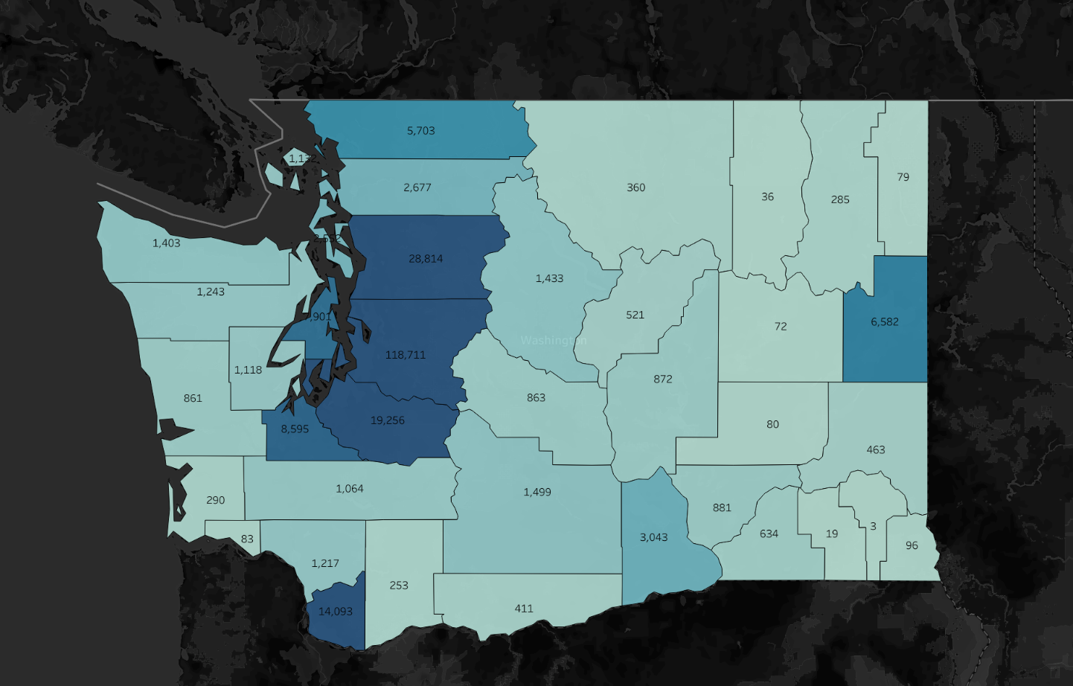
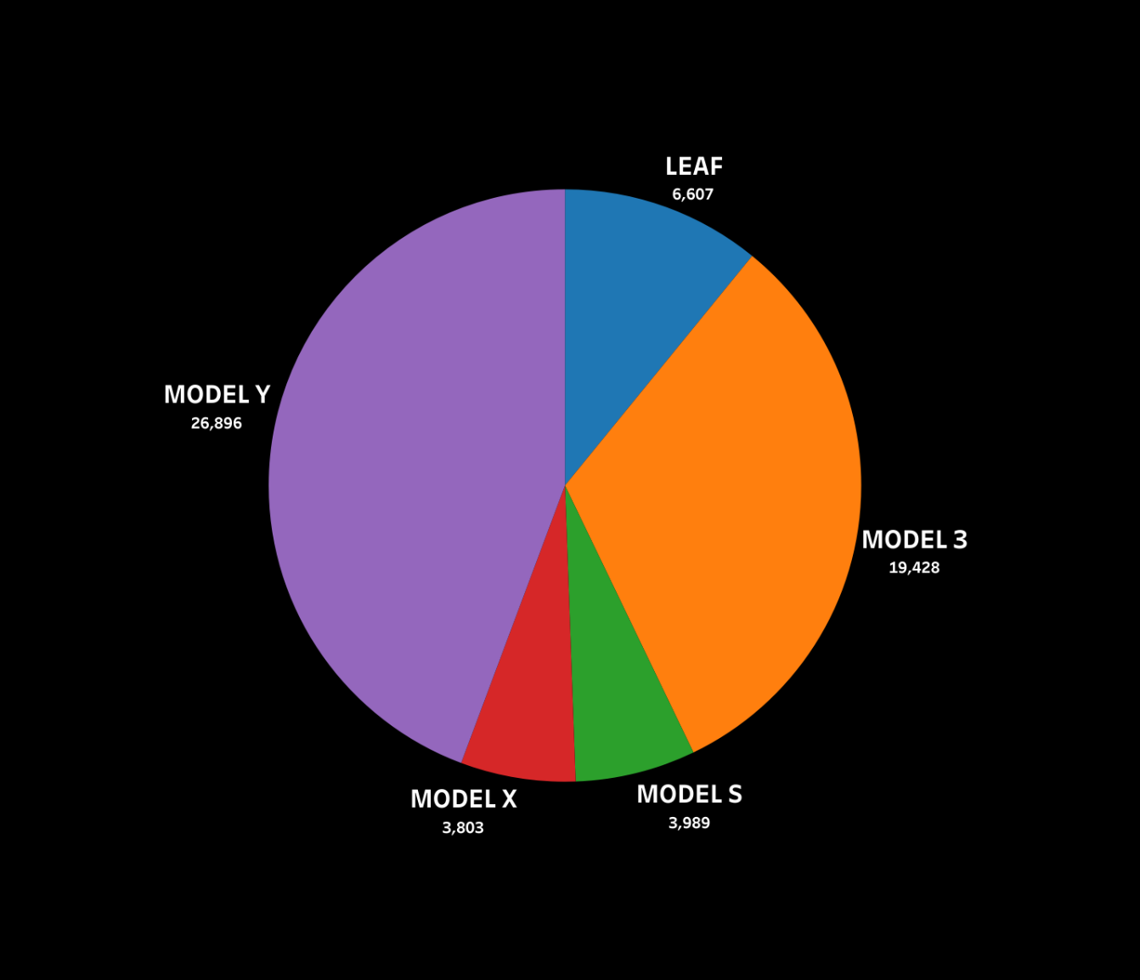
Registered Electric Vehicles in Washington State
Popular vehicles in King county
King County
THE WASHINGTONIANS

Slide 7
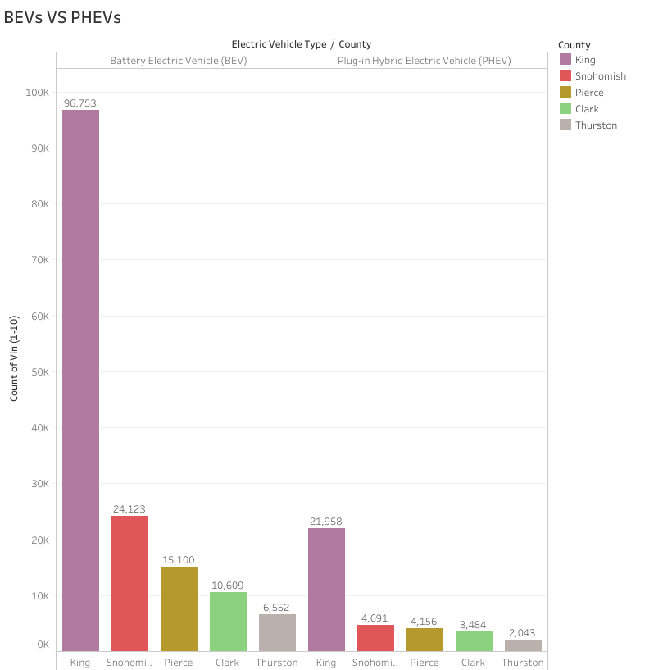
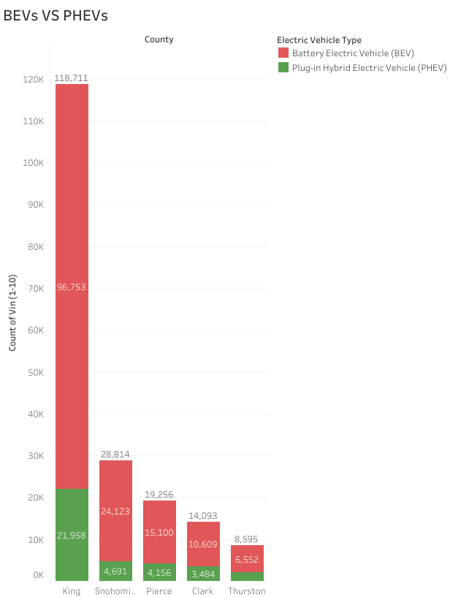
BEVs VS PHEVs in Washington State
THE WASHINGTONIANS

Slide 8
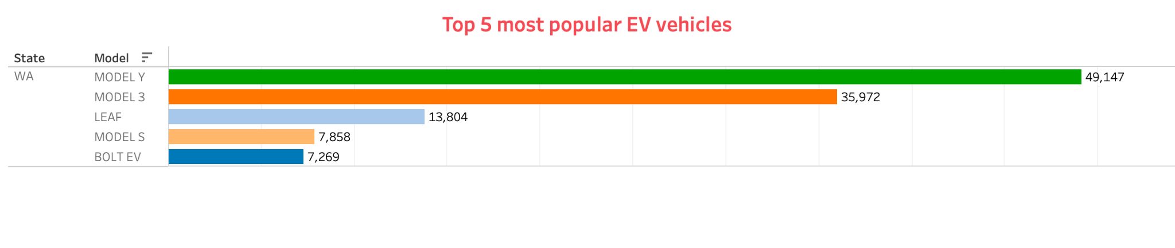
Top 5 Most Popular EV in Washington State
Tesla Model Y
Tesla Model 3
Nissan Leaf
Tesla Model S
Chevy Bolt EV
THE WASHINGTONIANS

Slide 9
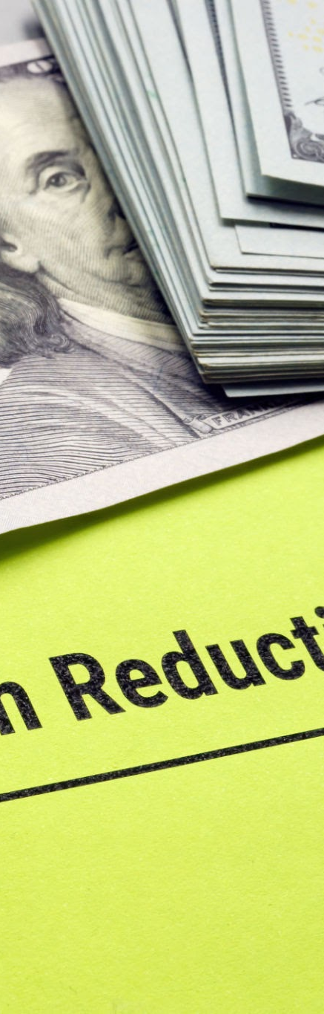
3
State Policies & Incentives
Zero-Emission Vehicle (ZEV) Mandate:
Washington state passed Clean Cars 2030 Bill on March 25, 2022
By 2035 only ZEVs will be sold in the state
Financial Incentives :
Sales and tax exemption
Up to $7,500 from federal government and up to $4,000 from the state to help pay for an EV
Infrastructure Accessibility:
Over $85 million in grants awarded to the state of WA to expand EV charging stations
Charging station grants are to prioritize underserved communities to ensure equal access

Slide 10

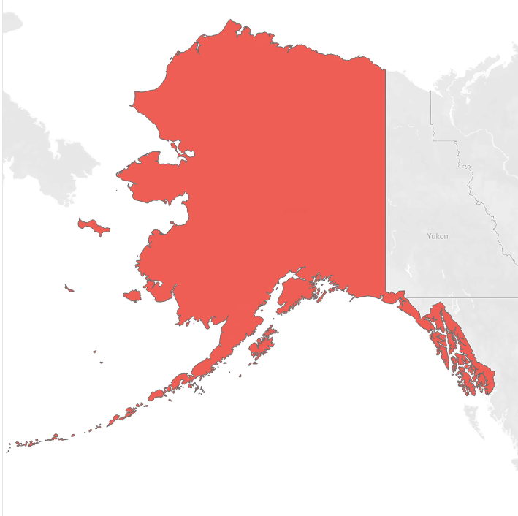
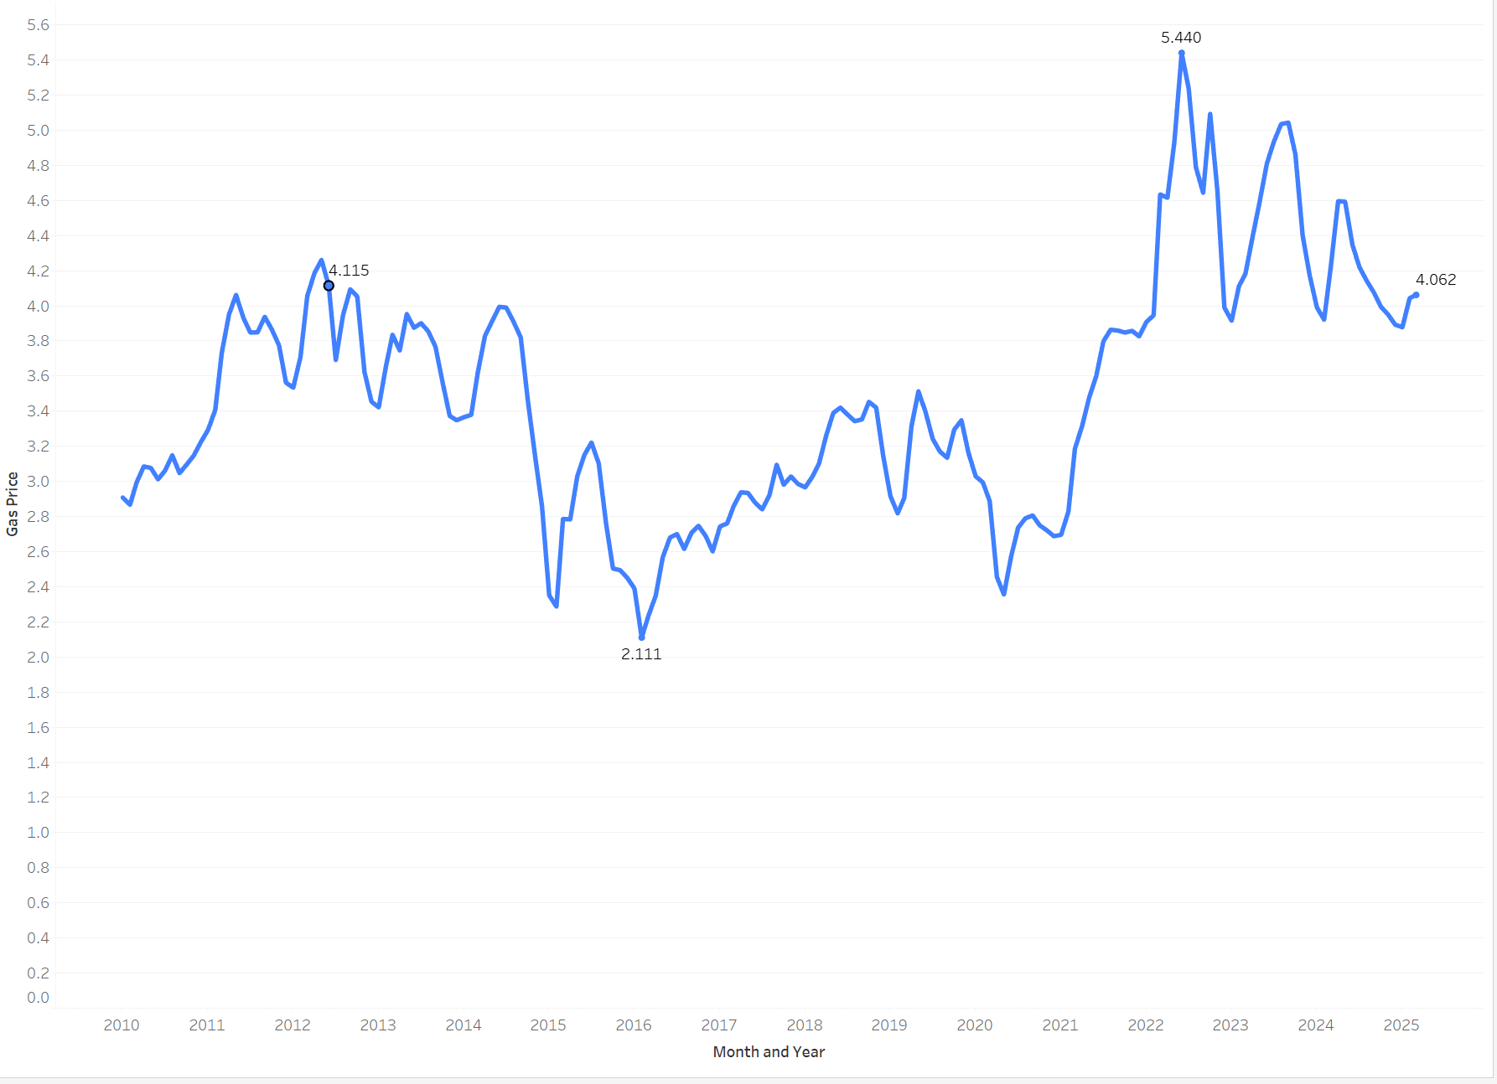
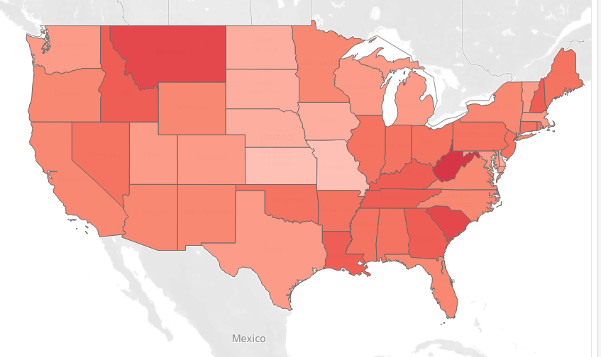
Gas vs Electric Price
$5.440
Hawaii
0.56/kWh
$4.062
Washington
0.32/kWh
$2.111
Gas Prices every Year
Current Electricity Price
THE WASHINGTONIANS

Slide 11
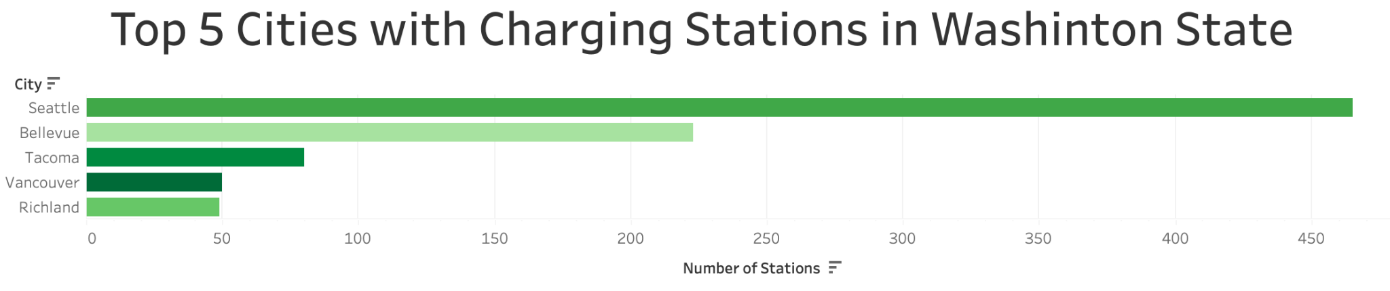
Seattle (King County): 465
Bellevue (King County): 223
Tacoma (Pierce): 80
Vancouver (Clark County): 50
Richland (Benton County): 49
THE WASHINGTONIANS

Slide 12
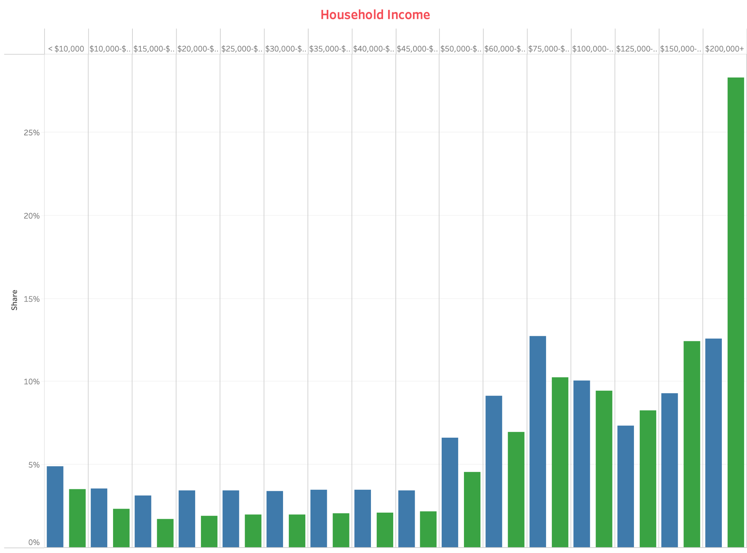
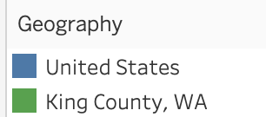
Income Distribution in King County
THE WASHINGTONIANS

Slide 13

4
Recommendations
King county presents the most strategic location for establishing an electric vehicle dealership in Washington state
Key moment to invest in EVs in the state of Washington due to their Clean Cars 2030 bill
Invest in a Nissan EV dealership as it is the 2nd most popular make and Tesla does not have dealerships

Slide 14
Sources
Electric Vehicle Population Data | Data.WA | State of Washington
EV Charging Prices
King County, WA | Data USA
Washington Electric Vehicle and EV Charging Laws
Electric Vehicles in Washington State
A Record Year For Electric and Plug-In Hybrid Vehicles in Washington
Alternative Fueling Stations
Department of Ecology: State of Washington
5

Slide 15
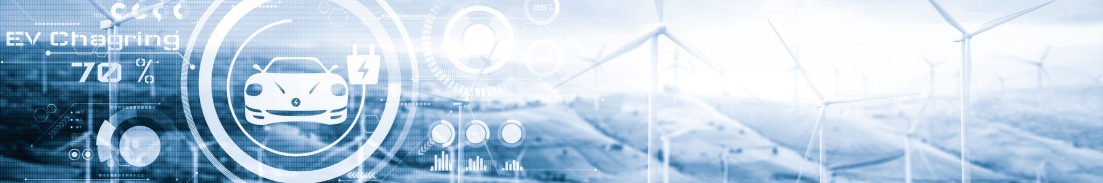
THANK YOU
THE WASHINGTONIANS
FANTASTIC4@THEWASHINGTONIANS.COM
123-456-7890

